Slide 1
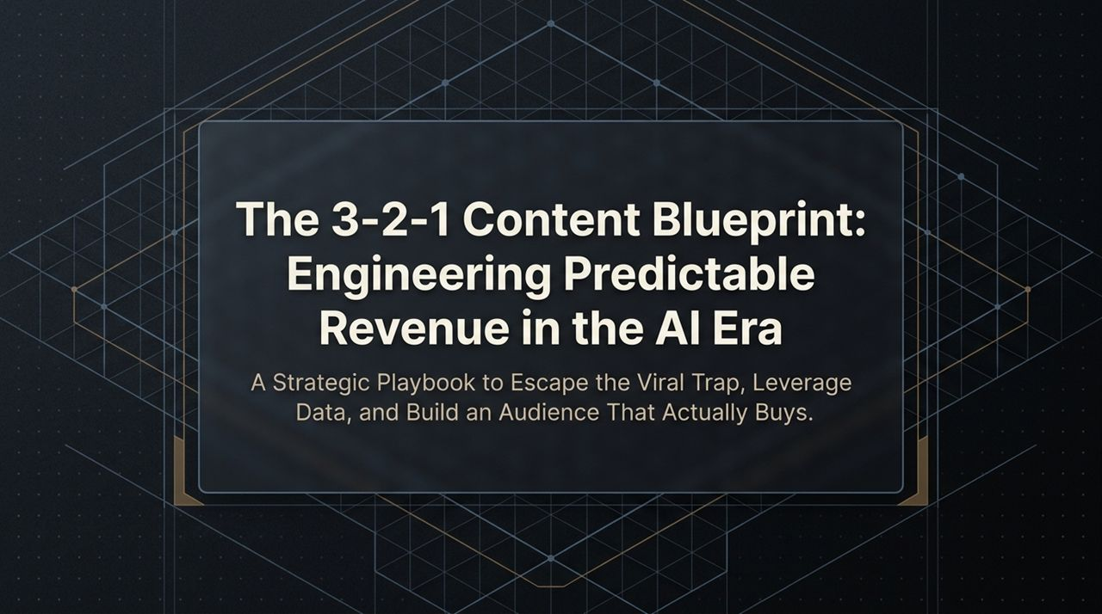
Notes:
Welcome everyone. Today, we are going to dive into a strategic framework called 'The 3-2-1 Content Blueprint: Engineering Predictable Revenue in the AI Era.'
Now, if you look at the landscape of short-form video and content marketing today, most creators and business owners are playing a game designed around a massive lie: the idea that more views equals more money. We see people chasing viral hits, trying to go viral for the sake of going viral, and hoping that eventually, someone in that sea of millions of viewers will buy their product or hire their service.
The reality is that chasing virality without a precise mechanism behind it is a trap. It results in what I call 'junk traffic'—an audience that watches, scrolls past, but never converts.
In this presentation, we are stepping away from 'viral chasing' and moving toward precision-based audience engineering. Over the next 16 slides, I’m going to share with you the exact operating model—supported by modern AI workflow integrations—that allows you to build an audience that actually buys. We’ll cover how to define your offers, engineer your target audience using a 5-Ring Bullseye strategy, script content using data-backed AI leverage, and deploy the 3-2-1 weekly content distribution architecture.
By the end of this session, you won't just have theoretical marketing ideas; you’ll have a structured, step-by-step playbook that you can execute in under 48 hours. Let’s get started.
https://www.youtube.com/watch?v=lZc30sUfx64

Slide 2
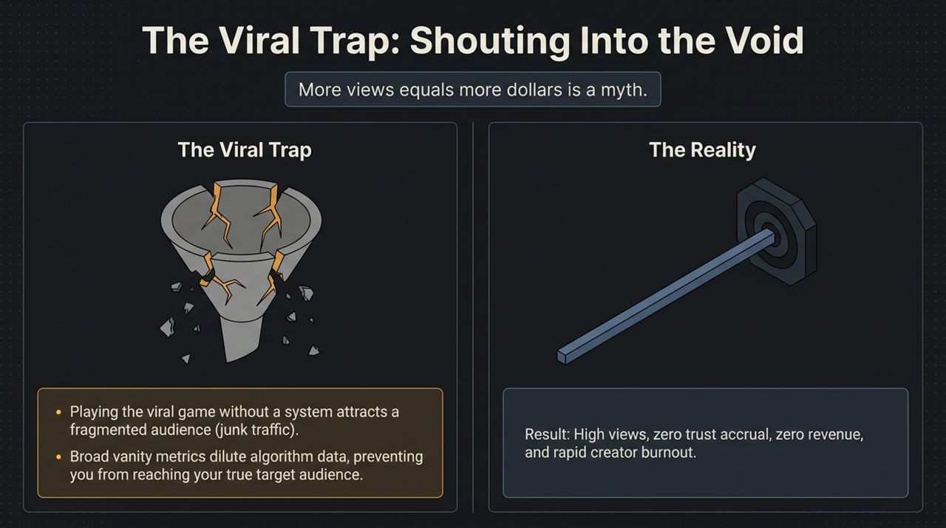
Notes:
Let's unpack Slide 2: The Viral Trap.
Look at the graphic on this slide: a broken funnel. That funnel represents what happens when you treat views as your primary business metric. The core myth we need to destroy right now is that 'More views equals more dollars.' In practice, getting a million views on a generic reel or TikTok often brings zero dollars in scalable revenue.
Why does this happen? First, when you play the viral game without a clear target system, you attract a fragmented, low-intent audience. You end up with 'junk traffic'—people who like a funny joke or a broad productivity tip, but have zero budget, zero authority, and zero interest in buying a high-ticket service or specialized product.
Second, broad vanity metrics actually destroy your distribution on social algorithms. Modern algorithms on platforms like Instagram, TikTok, and YouTube Shorts rely heavily on audience data feedback loops. When your content attracts everyone, the algorithm gets confused. It doesn't know who your ideal customer is, so it stops serving your content to decision-makers.
As you see at the bottom of the slide, the ultimate result of this trap is high views, zero trust accrual, zero revenue, and rapid creator burnout. You spend dozens of hours scripting and editing videos, hit 100k views, check your stripe account, and see $0. That is the cycle we are breaking today.

Slide 3
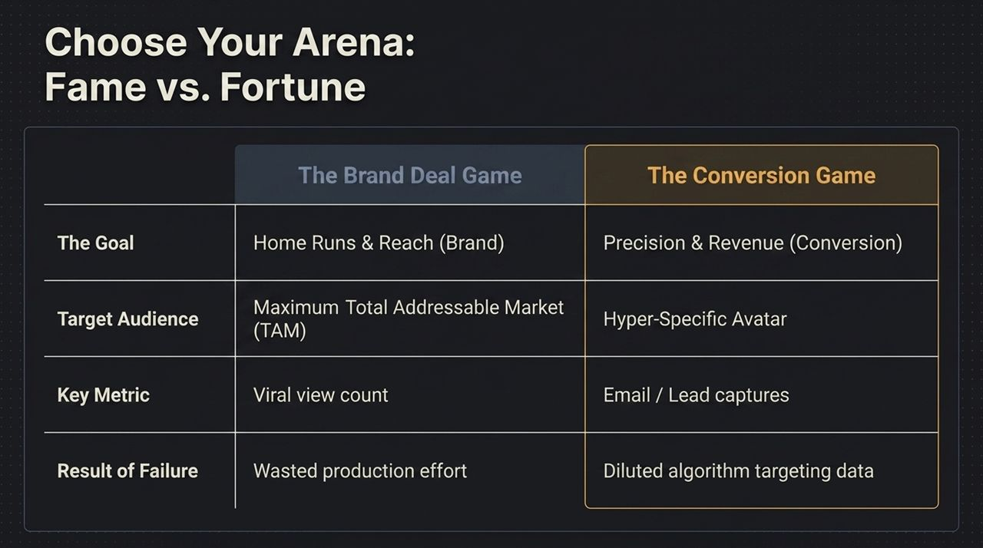
Notes:
To build a predictable revenue engine, you have to decide which game you are playing. On Slide 3, we contrast the two arenas: The Brand Deal Game (Fame) versus The Conversion Game (Fortune).
Let's break down the differences across four main vectors:
The Goal: The Brand Deal Game aims for home runs, massive reach, and general brand awareness. The Conversion Game aims for precision, trust, and predictable backend revenue.
Target Audience: In the Fame game, you try to reach the widest total addressable market (TAM) possible. In the Conversion game, you focus on a hyper-specific avatar—a narrow group of people who share an exact pain point that your offer solves.
Key Metric: The Brand Deal creator looks at view counts, impressions, and follower totals. The Conversion player tracks email opt-ins, booked calls, and high-intent lead captures.
Result of Failure: If a viral creator fails, they waste production effort. If a conversion creator fails, they dilute their algorithm targeting data.
If you are an enterprise founder, a service provider, or an expert, you do not need 1 million followers. You need 10,000 or 50,000 of the right followers who view you as the authority in your space. That is how you turn an audience into an engine that generates sustainable revenue.

Slide 4
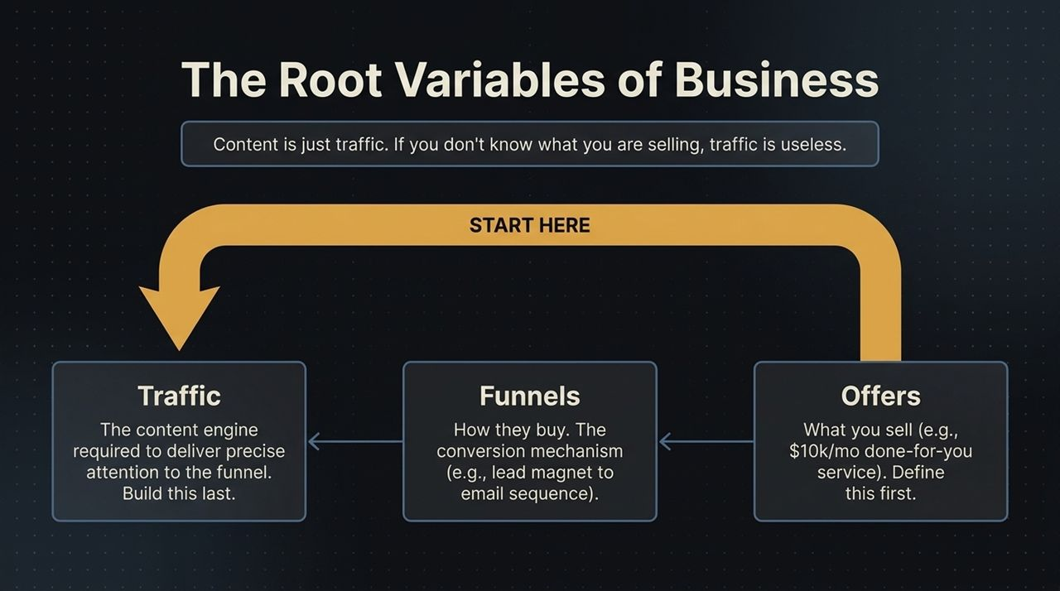
Notes:
Now let me present the single biggest structural mistake people make when launching a content channel. Look at Slide 4: The Root Variables of Business. Most creators start on the far left: they start producing traffic (content) first, without ever establishing their funnel or their offer.
Here is the reality: Content is just traffic. If you don't know what you are selling, traffic is completely useless. Sending 100,000 people to a broken page or an undefined product yields $0.
You must build your content architecture from right to left:
Step 1: Offers (Define First): What are you selling? Is it a $10k/month done-for-you service? A specialized consulting package? An enterprise software? You must know the price point, the solution, and the exact buyer before writing a single script.
Step 2: Funnels (Define Second): How do people buy? What is the exact conversion mechanism? Is it a lead magnet that drives people to an email sequence? A direct link to a booking calendar? A direct-response sales page?
Step 3: Traffic (Build Last): Only after the offer and funnel are clear do you build the content engine. Your content's only job is to deliver precise attention into that pre-built funnel.

Slide 5
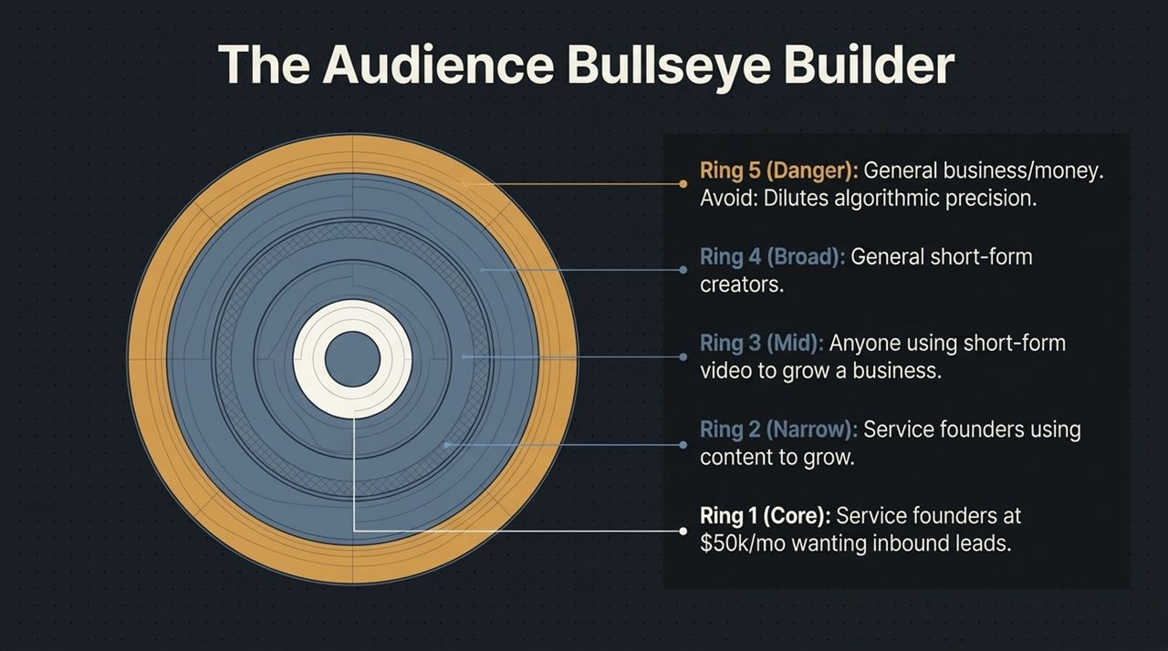
Notes:
Slide 5 shows The Audience Bullseye Builder—our framework for categorizing target audiences into 5 concentric rings.
To build content that converts, you must map your topic relevance across these five layers:
Ring 5 (Danger Zone - Outer Edge): General business or broad money advice (e.g., 'How to make money online'). Avoid this ring. It dilutes your algorithmic data and brings in low-intent, tire-kicker traffic.
Ring 4 (Broad): General content creators or short-form video creators. Broad appeal within your industry, useful for top-of-funnel reach.
Ring 3 (Mid): Anyone using short-form video or marketing to grow a business.
Ring 2 (Narrow): Service business founders using content specifically to drive inbound growth.
Ring 1 (Core Bullseye): Service founders making $50k/month who need predictable inbound leads right now.
Notice how as you move inward from Ring 4 to Ring 1, your reach shrinks, but your lead quality and buying intent explode. Understanding these rings is essential for the 3-2-1 content architecture we are about to discuss.

Slide 6
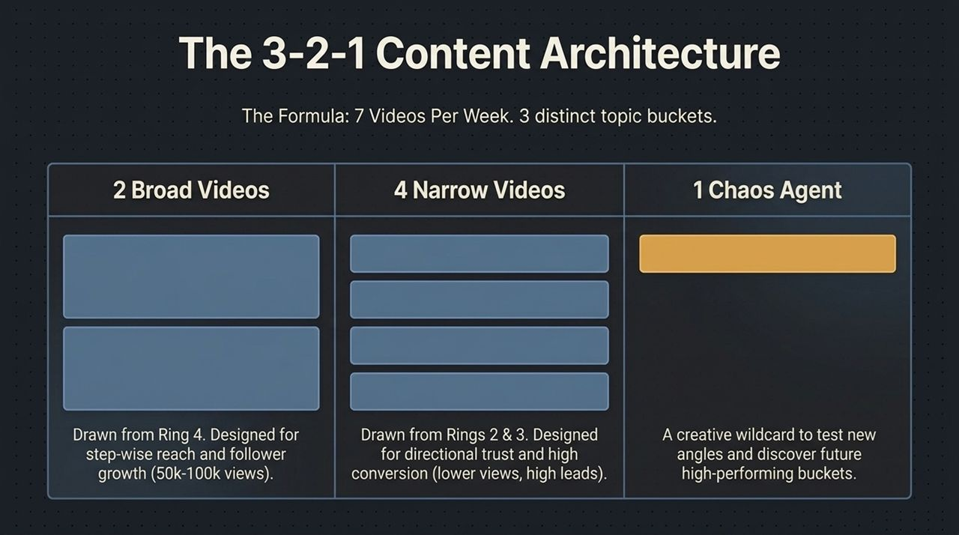
Notes:
Now let's break down Slide 6: The 3-2-1 Content Architecture—the core framework of this presentation.
To maintain momentum, capture new audience, and convert leads systematically, you publish 7 videos per week divided into 3 distinct topic buckets:
3 Broad Videos (Ring 4): Drawn from your broader topic rings. These videos address common industry concepts designed for step-wise reach, follower growth, and algorithm momentum (targeting 50k–100k+ views).
2 Narrow Videos (Rings 2 & 3): Deeply specific, technical, or tactical videos aimed directly at your core target avatar. While these may get fewer total views, they build high directional trust and drive the highest rate of lead conversions.
1 Chaos Agent: A creative wildcard video each week. This is where you test an unexpected hook, a new storytelling format, or an unproven angle. The Chaos Agent keeps your content from becoming stale and helps discover future high-performing topic buckets.
This 3-2-1 ratio creates a balanced content engine that consistently feeds top-of-funnel discovery while converting bottom-of-funnel leads.

Slide 7
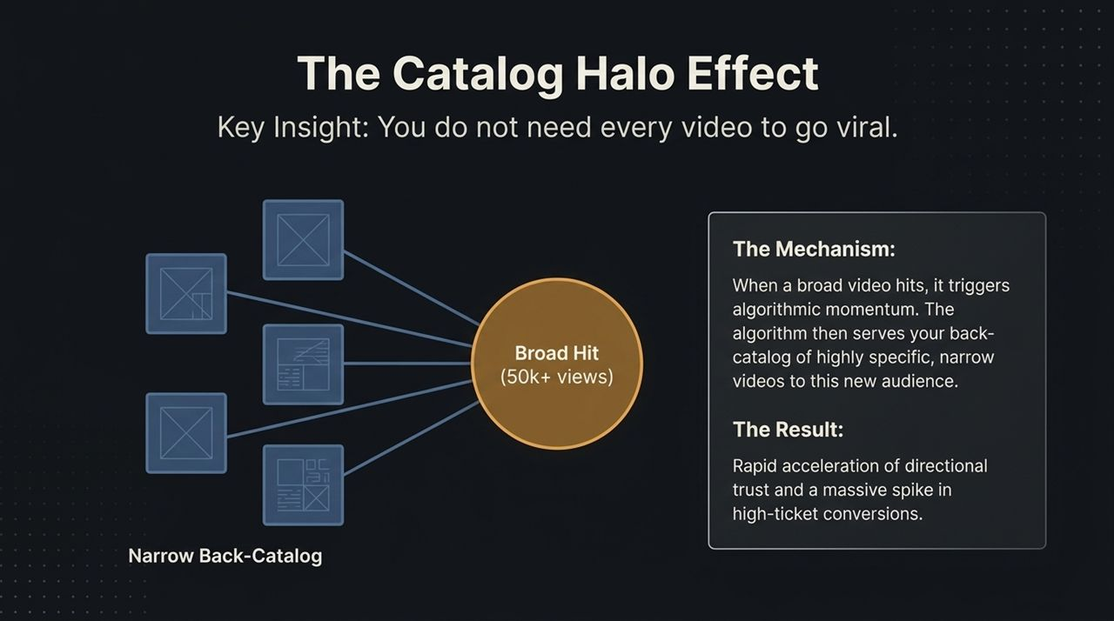
Notes:
A common objection is: 'If my narrow videos get lower views, isn't that going to hurt my channel?'
Slide 7 illustrates The Catalog Halo Effect—the mechanism that turns low-view, high-value videos into revenue. You do not need every video to go viral.
How it works:
When one of your Broad Videos hits and gets algorithmic traction (e.g., 50k+ views), the platform's algorithm begins recommending your profile and back-catalog to those new viewers.
When high-intent prospects enter your profile, they don't just watch more broad content—they scroll through your Narrow Back-Catalog.
Watching 2 or 3 of your hyper-specific, narrow tactical videos builds immediate trust. They realize you possess deep expertise in solving their exact problem.
The broad video gets them through the door; the narrow back-catalog converts them into high-ticket clients.

Slide 8
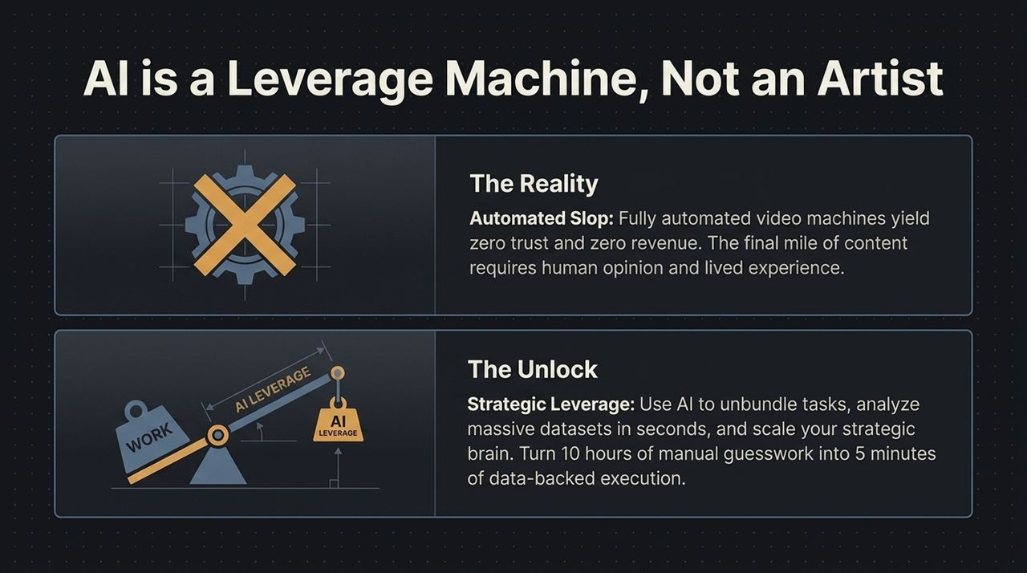
Notes:
Now let's discuss AI's role in this system. Look at Slide 8: AI is a Leverage Machine, Not an Artist.
The Reality / The Trap: Fully automated AI video pipelines—where AI generates the script, avatar, voiceover, and editing without human touch—yield 'automated slop.' These videos build zero trust and drive zero revenue. In high-ticket services and B2B sales, buyers purchase based on human authority, lived experience, and genuine opinions.
The Unlock: Treat AI as a Leverage Machine. Use AI to unbundle manual tasks, analyze competitor datasets, identify structural hook patterns, and scale your strategic thinking.
AI allows you to compress 10 hours of manual research and guessing into 5 minutes of data-backed execution, leaving you free to focus on authentic delivery.

Slide 9
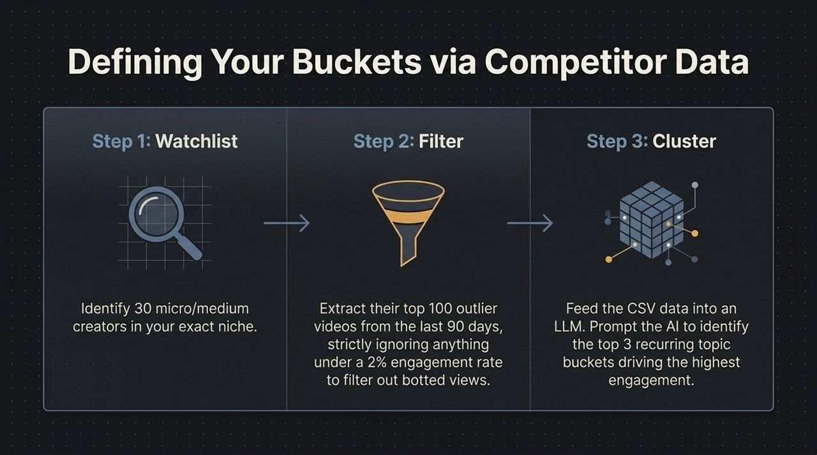
Notes:
Instead of guessing what topics your audience cares about, use data. Slide 9 outlines our 3-step workflow for defining content buckets using competitor analysis:
Step 1: Watchlist: Identify 30 micro to medium creators in your exact market niche.
Step 2: Filter: Extract their top 100 outlier videos from the last 90 days. Strictly filter out any video with under a 2% engagement rate to eliminate bot traffic and artificial inflation.
Step 3: Cluster: Export this video dataset into a CSV file and feed it into an LLM (like Claude or ChatGPT). Prompt the AI to group the highest-performing titles and transcripts into the top 3 recurring topic buckets driving real engagement.
This process eliminates creative guesswork and grounds your strategy in proven market demand.

Slide 10
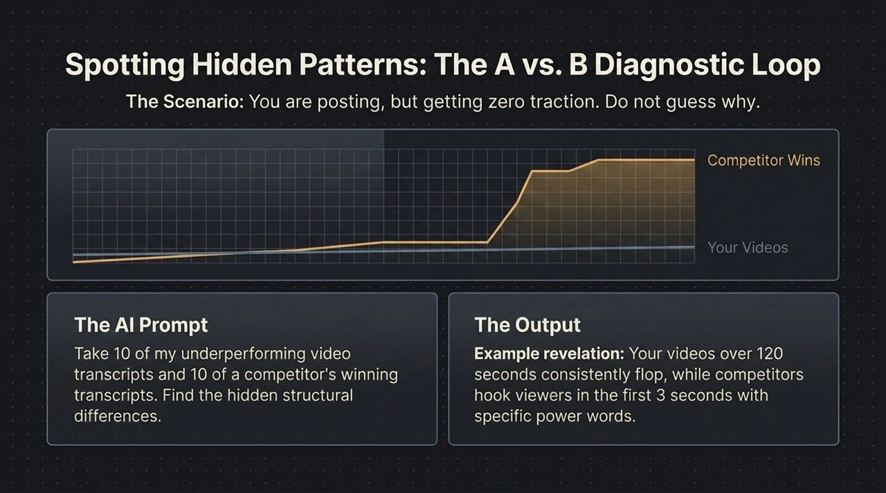
Notes:
If you are posting content regularly but failing to gain traction, don't guess what's wrong. Use Slide 10: The A vs. B Diagnostic Loop.
The Diagnostic Prompt: Take 10 transcripts from your underperforming videos and 10 transcripts from a competitor's top-performing outlier videos. Feed both sets into an LLM and ask: 'Identify the hidden structural and phrasing differences between Group A (underperforming) and Group B (winning).' =
Sample Output Insights:
You might discover your scripts run over 120 seconds with slow intros, whereas winning videos establish their hook within the first 3 seconds.
You might find competitors use specific power words or direct problem statements, while your scripts use passive or general language.
This simple diagnostic loop gives you immediate, actionable feedback to fix your content.

Slide 11
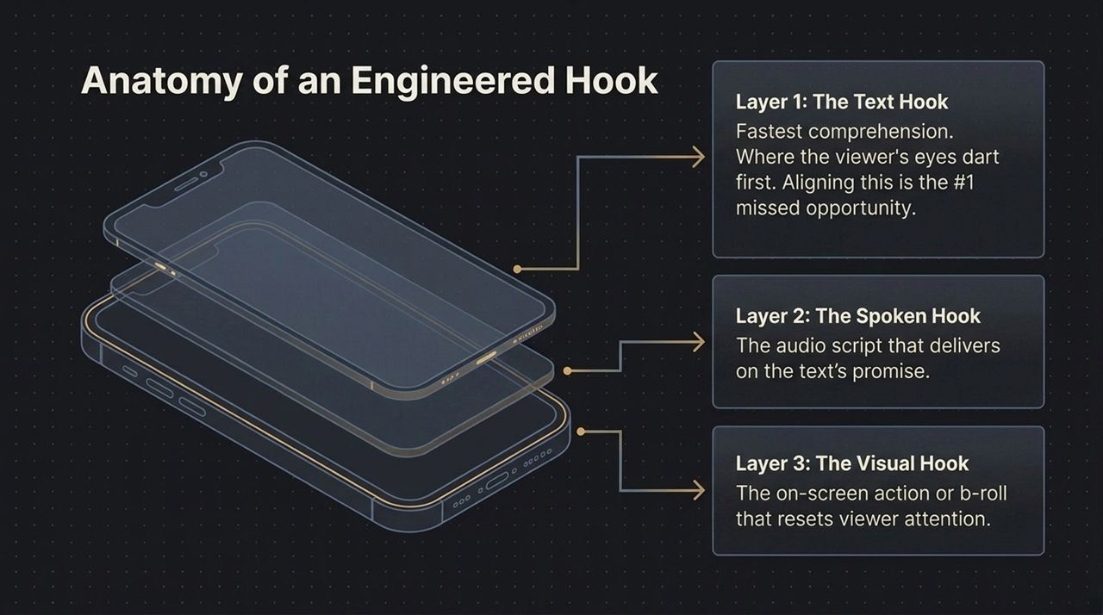
Notes:
The first 3 seconds of a short-form video determine whether a viewer stays or scrolls. Slide 11 breaks down the 3 Layers of an Engineered Hook:
Layer 1: The Text Hook (Visual Text): This is where the viewer's eyes go first. On-screen text must be concise, punchy, and instantly readable. Misalignment between visual text and audio is a common reason viewers scroll away.
Layer 2: The Spoken Hook (Audio Script): The opening sentence delivered verbally. It must immediately fulfill the promise made by the visual text hook.
Layer 3: The Visual Hook (On-Screen Action / Movement): On-screen movement, direct eye contact, or relevant B-roll that resets viewer attention within the first second.
When all three layers work together, you significantly increase your viewer retention rates.
Slide 12: Hook Engineering &

Slide 12
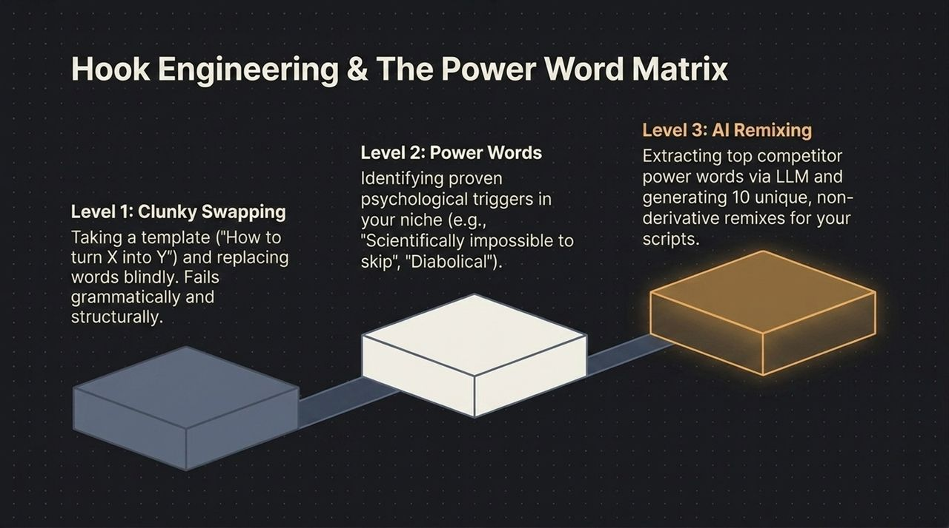
Notes:
Slide 12 illustrates the evolution of hook writing—from basic template copying to advanced AI power-word engineering:
Level 1: Clunky Swapping: Taking generic templates (e.g., 'How to turn X into Y') and replacing words blindly. This often yields unnatural phrasing that performs poorly.
Level 2: Power Words: Identifying psychological triggers specific to your niche (e.g., phrasing like 'Scientifically impossible to skip' or 'Diabolical strategy').
Level 3: AI Remixing: Extracting top competitor power words using an LLM and generating 10 unique, non-derivative variations tailored to your specific offers.
Mastering Level 3 allows you to produce high-converting hooks quickly without sounding derivative.

Slide 13
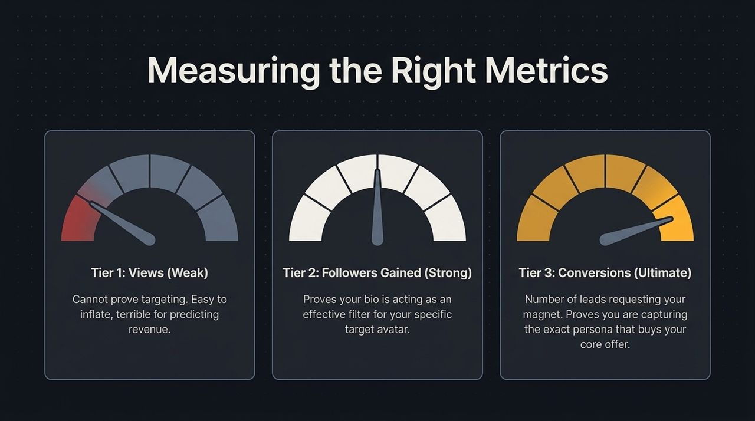
Notes:
To ensure your content strategy stays on track, you must measure the right variables. Slide 13 outlines our 3-Tier Metric Pyramid:
Tier 1: Views (Weak): High view counts feel good, but they do not guarantee audience alignment or predictable revenue.
Tier 2: Followers Gained (Strong): Tracking follower growth shows that your bio and profile act as an effective filter for your target avatar.
Tier 3: Conversions (Ultimate Metric): The number of leads requesting your lead magnets, booking calls, or opting into your sales funnel. This confirms you are attracting buyers who want your core offer.
Evaluate your content performance primarily against Tier 3 metrics.

Slide 14
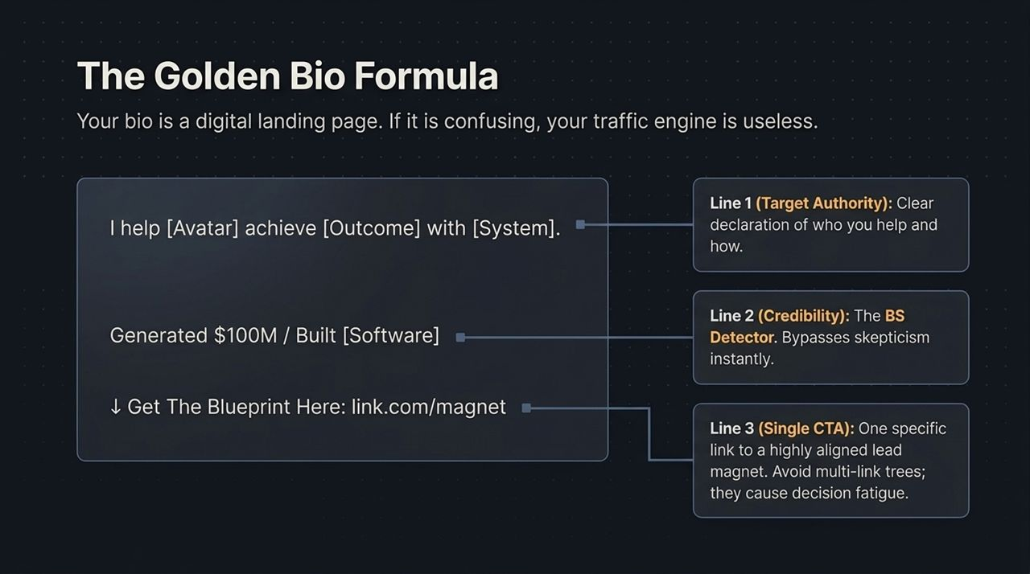
Notes:
Your social media bio functions as a landing page. If your bio is confusing or vague, your traffic engine won't convert. Slide 14 presents The Golden Bio Formula:
Line 1 (Target Authority): 'I help [Avatar] achieve [Outcome] with [System].' State clearly who you help and how.
Line 2 (Credibility): Provide a clear social proof point or achievement (e.g., 'Generated $100M' or 'Built [Software]' ) to establish immediate authority.
Line 3 (Single Call to Action): Provide a single link pointing directly to your primary lead magnet or sales funnel. Avoid multi-link trees, which create decision fatigue and lower conversion rates.

Slide 15
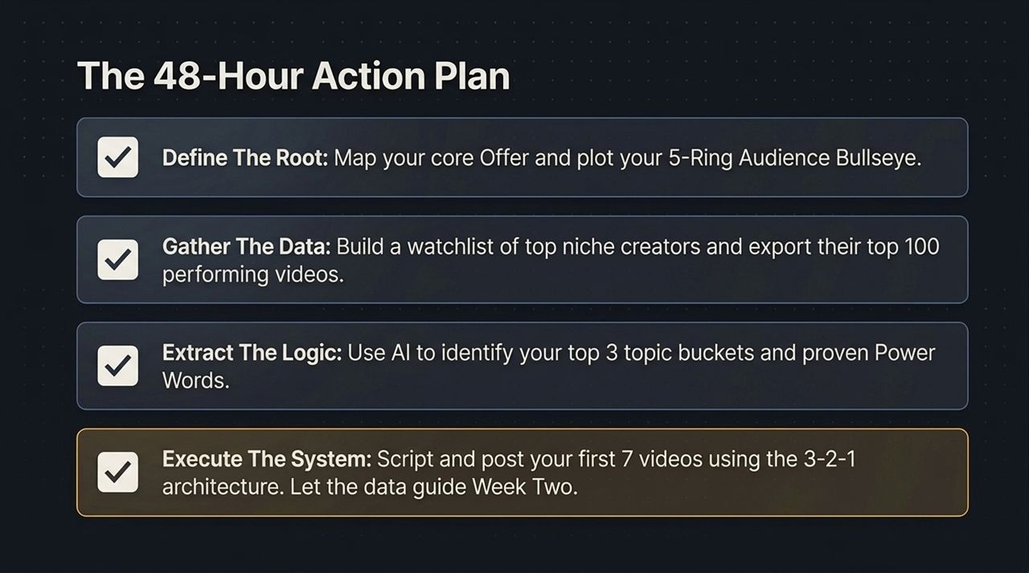
Notes:
Here is your operational roadmap for the next 48 hours:
Define The Root: Clarify your core offer and map out your 5-Ring Audience Bullseye.
Gather The Data: Build a watchlist of top creators in your niche and export their top-performing video datasets.
Extract The Logic: Use AI to analyze the data, identify your top 3 topic buckets, and extract proven power words.
Execute The System: Script, record, and post your first 7 videos using the 3-2-1 distribution ratio, then let the performance data guide week two.

Slide 16
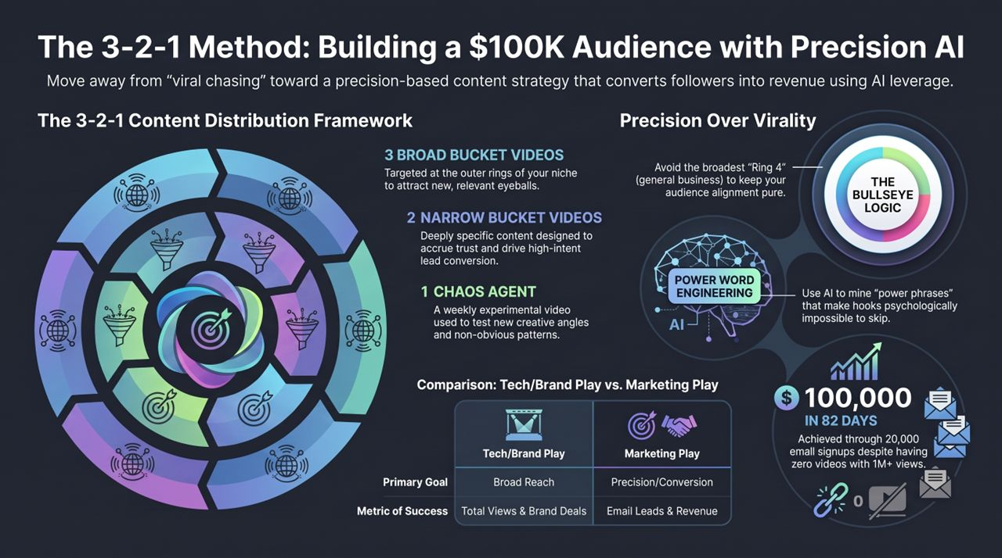
Notes:
To wrap up, let's review the outcome of applying this framework on Slide 16.
By shifting from a broad reach strategy to precision AI-driven targeting, this framework generated $100,000 in 82 days. This was achieved through 20,000 targeted email signups, despite having zero videos cross 1 million views.
This outcome illustrates the difference between chasing general virality and building a structured conversion engine. Focus on audience precision, leverage AI for research and script optimization, and execute the 3-2-1 content framework consistently.
Thank you for your time. Let's move into Q&A.

